Slide 1





Federal Relief Dollars in Action – A Community Conversation
June 10, 2021

Slide 2
Overview
  Let’s Connect series
To provide a venue for the community to share perspectives on topics relevant to our district and how we serve our students
  Purpose for tonight
Develop a deeper understanding of the timing and intended uses of federal relief funding known as Elementary and Secondary School Emergency Relief (ESSER) funds
Provide an update on the utilization of ESSER I & II to offset the immediate COVID fiscal impacts and resulting state funding cuts
Celebrate the “land of opportunity” to support learning recovery, social-emotional health, and equitable access for all students
Review a 2-year draft of the ESSER III spending plan and provide feedback

Slide 3
Overview
  Presentation focuses on key questions
How are school districts funded and where does ESSER fit in?
What is the timing for use of federal relief funds (ESSER I, II, & III)?
How is ESSER allocated to school districts?
How have ESSER I and II funds helped?
How is planning for ESSER III different from ESSER I & II?
What are the allowable uses of ESSER III?
What draft investments are planned for ESSER III?
  Conversation will focus on two questions
Given that ESSER III is providing a “land of opportunity,” what
other investments should be considered to support our students?
2. What key messages are most important to emphasize with our families and the community at large?

Slide 4
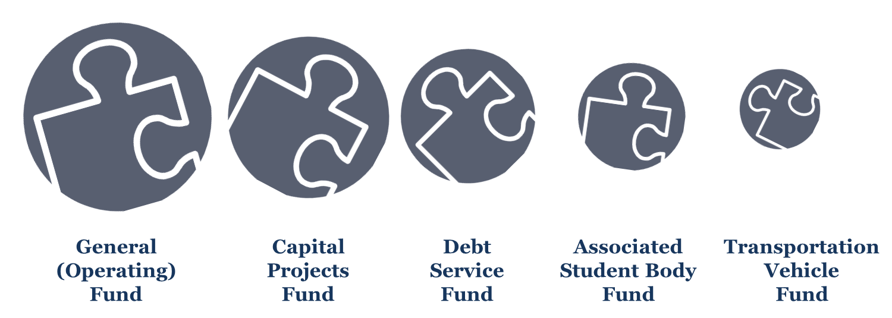
How are school districts funded?
  ESSER primarily supports the General Fund
  General fund is also known as the operating fund
  ESSER can be applied to some capital costs such as HVAC
  ESSER can help cover general fund cost used to support ASB
$358,243,000
$71,4867,000
$56,587,000
$2,720,000
$121,000

Slide 5
What is the timing for use of ESSER?
  Federal relief approved in three Acts
ESSER I – The Coronavirus Aid, Relief, and Economic Security (CARES) Act, signed into law March 27, 2020
  Reimburses eligible expenditures March 13, 2020 – September 30, 2021
ESSER II – The Coronavirus Response and Relief Supplemental Appropriations (CRRSA) Act, signed into law December 27, 2020
  Reimburses eligible expenditures March 13, 2020 – September 30, 2022
ESSER III – The American Rescue Plan (ARP) Act of 2021, signed into law on March 11, 2021
  Reimburses eligible expenditures March 13, 2020 – September 30, 2023
All three acts allow funds to be carried forward one additional year
Notes:
A picture from the first day of school. Students overjoyed to be with their friends and their principal.

Slide 6
What is the timing for use of ESSER?
  Districts encouraged to follow first in, first out
Districts may access unused funds for one year beyond deadline
Notes:
A picture from the first day of school. Students overjoyed to be with their friends and their principal.

Slide 7
How is ESSER allocated to districts?
  ESSER is allocated by the Title I formula
Legislature relied upon ESSER to cover enrollment funding loss
OSPI estimated Everett’s enrollment loss to be $8.2 million
Legislature provide stabilization dollars for districts with lower ESSER allocations to offset enrollment funding loss
Source: Office of Superintendent of Public Instruction
Notes:
Mukilteo 3.06 Everett 3.51 Edmonds 2.25 Snohomish 6.57 - Lake stevens 4.05 Arlington 7.37 Marysville 3.29 Monroe 7.97

Slide 8
How is planning for ESSER III different?
  Funding increase provides great opportunity
ESSER I and II helped with immediate and ongoing COVID costs
  Offset direct COVID costs for PPEs and cleaning
  Offset state revenue shortfalls
  Offset higher operational costs such as unemployment
  Offset local revenue shortfalls such as lunch fees
  Funded added costs for the reopening schools in hybrid
ESSER III More restrictive and required Academic
and Student Well-being Recovery Plan (ASWRP)
  Plan was submitted to OSPI on June 1
ESSER III Provides greater opportunity to fund student supports
  Superintendent emphasized this as a top priority
  2-year big picture necessary to ensure adequacy, sustainability, and pace
  Program/budget authorities identified (brainstormed) numerous possibilities
  Draft plan was prepared for review and input with stakeholders

Slide 9



What are the allowable uses of ESSER III?
  Allowable instructional supports
Instructional categories are eligible over the next 28 months
Allowable uses include:
  Accelerated Learning Opportunities
  Summer & Supplemental Learning Programs
  Mental Health Services & Supports
  Equitable Access Activities
  ESSA and IDEA Activities
  Carl D. Perkins CTE Activities
  Title VII McKinney-Vento Homeless Activities
  Individual School Needs

Slide 10



What are the allowable uses of ESSER III?
  Allowable operational supports
Instructional categories are eligible over the next 16 months
Allowable uses include:
  Public Health Coordination (external)
  Preparedness & Response Efforts (internal)
  Sanitize & Clean Facilities
  Planning for Long-Term Closures
  Educational Technology
  Facility Repairs to Reduce Transmission
  Projects to Improve Indoor Air Quality
  Continuity of District Services

Slide 11
What is the draft plan for ESSER III?
  Majority of funding supports student needs
59.2% dedicated to accelerated learning opportunities
Another 16.0% focuses on mental health and equitable access
Notes:
A picture from the first day of school. Students overjoyed to be with their friends and their principal.

Slide 12
What is the draft plan for ESSER III?
  Year 1 – Summer 2021
Notes:
A picture from the first day of school. Students overjoyed to be with their friends and their principal.

Slide 13
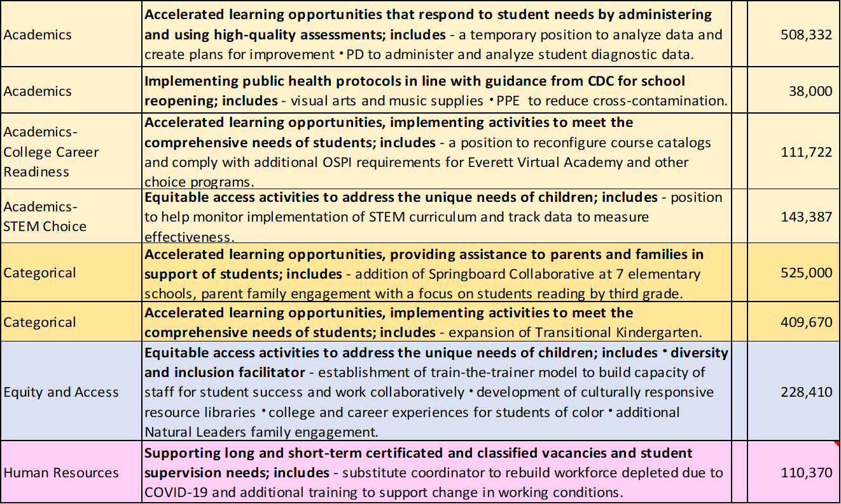
What is the draft plan for ESSER III?
  Year 1 – 2021-22 school year
Notes:
A picture from the first day of school. Students overjoyed to be with their friends and their principal.

Slide 14
What is the draft plan for ESSER III?
  Year 1 – 2021-22 school year (continued)
Learning and Info. Technology Services | Purchasing educational technology for students that aids in educational interaction between students and their classroom instructors; includes - providing hotspots for families without internet connection at home purchase and repair of elementary Chromebooks not included in 1:1 program purchase of peripherals as needed. |  | 830,000
Learning and Info. Technology Services | Providing principals with the resources necessary to address the needs of their individual schools; includes - an office support position at each comprehensive high school focused on the transition back to school and increase in technology-related clerical duties. |  | 144,918
Learning and Info. Technology Services | Equitable access activities to address the unique needs of children; includes - replacement of computers for KIT students as needed a field technician focused on supporting Special Education and assistive technology as students and staff transition back into the classroom. |  | 215,912
Maintenance and Custodial | School facility repairs/improvements and equipment/supplies to reduce the risk of virus transmission and support student health needs; includes - HVAC technician HVAC system maintenance and service agreements replacement of damaged plexiglass hygiene shields indoor air purifiers high efficiency filters. |  | 1,671,555
Maintenance and Custodial | Implementing public health protocols in line with guidance from the Centers for Disease Control and Prevention for school-reopening; includes - personal protective equipment (PPE) custodial staff to support additional cleaning and disinfection requirements. |  | 972,778
Maintenance and Custodial | Implementing public health protocols in line with guidance from the Centers for Disease Control and Prevention for school-reopening; includes - Purchasing additional supplies to sanitize and clean the facilities in compliance with COVID-19 requirements. |  | 500,000
Notes:
A picture from the first day of school. Students overjoyed to be with their friends and their principal.

Slide 15
What is the draft plan for ESSER III?
  Year 1 – 2021-22 school year (continued)
Notes:
A picture from the first day of school. Students overjoyed to be with their friends and their principal.

Slide 16
What is the draft plan for ESSER III?
  Year 2 – Summer 2022 & 2022-23 school year
Notes:
A picture from the first day of school. Students overjoyed to be with their friends and their principal.

Slide 17
What is the draft plan for ESSER III?
  Year 2 – Summer 2022 & 2022-23 school year
Notes:
A picture from the first day of school. Students overjoyed to be with their friends and their principal.

Slide 18
Where are we in the process?
  Key steps in proposal implementation
ASWRP plan was submitted to OSPI providing access to funds
Internal process to more specifically identify 2-year investment opportunities has been completed
Stakeholder engagement is underway
  June 7 Fiscal Advisory Council
  June 10 Administrators and supervisors
  June 10 Let’s Connect
Please help by responding to the following post-meeting survey:
  What are the strengths of the proposed plan?
  What questions or concerns do you have?
  Given what you have learned about allowable uses, what other investments should be considered over the next 28 months?
Notes:
A picture from the first day of school. Students overjoyed to be with their friends and their principal.

